Slide 1
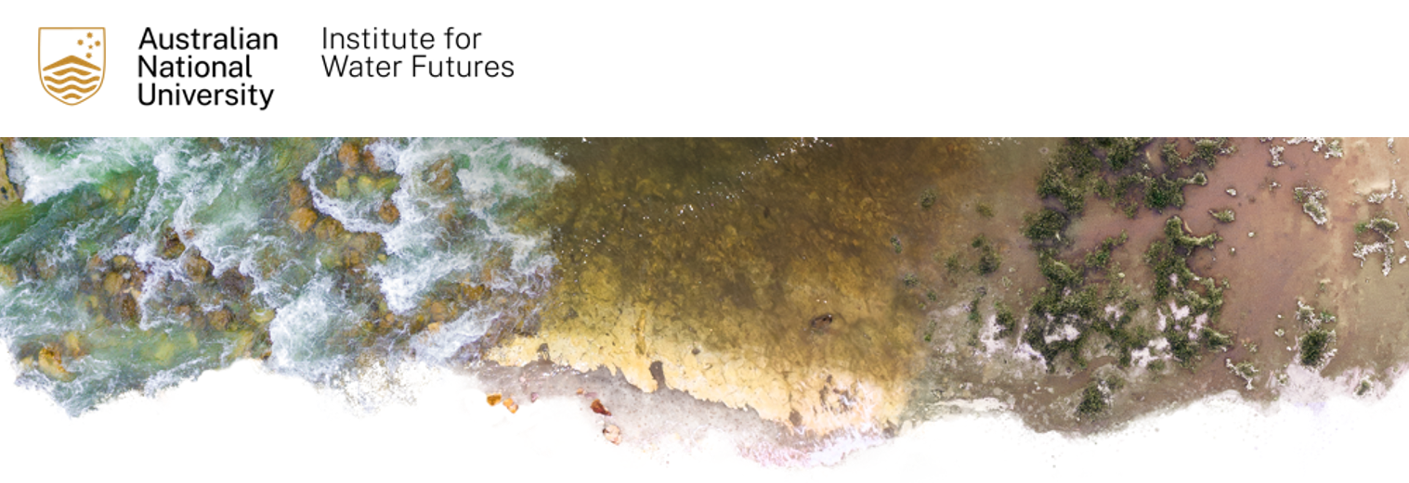

Learning focused digital twins
Joseph Guillaume, Natasha Harvey, and Wendy Merritt (ANU), Niilo Gobius, Lars Kazmeier, John McLaughlin and Zoe Williams (Gulf Savannah NRM)

Slide 2
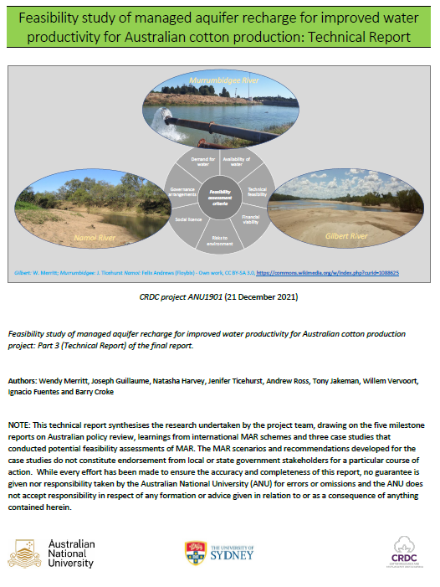
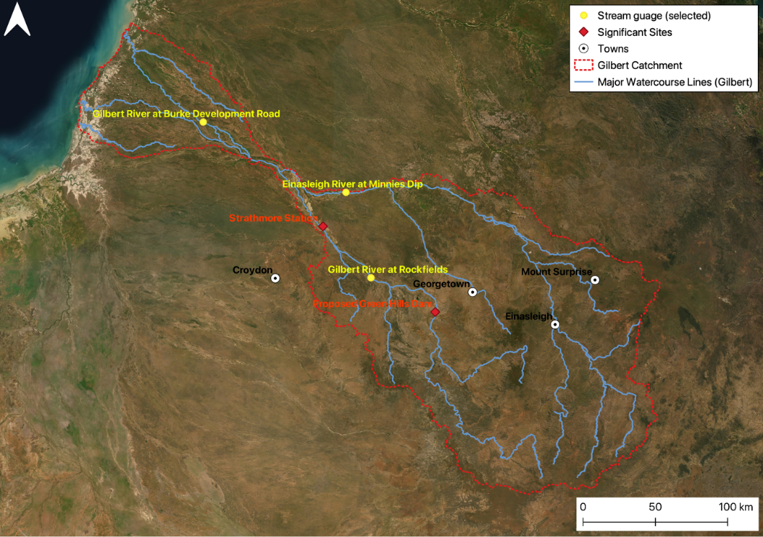
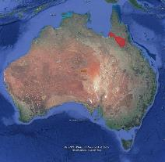
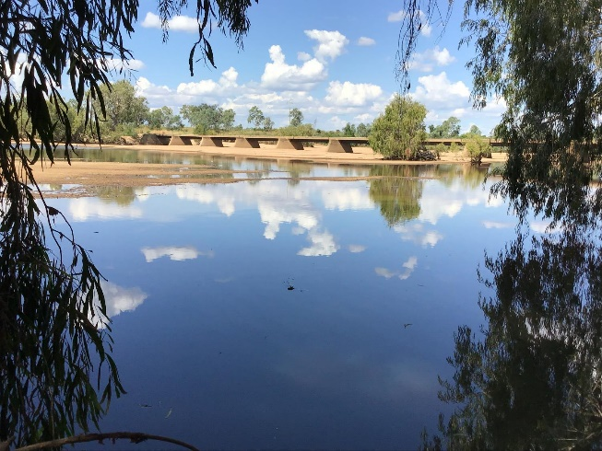
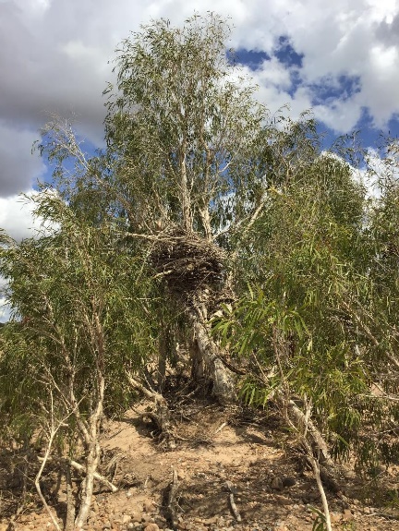
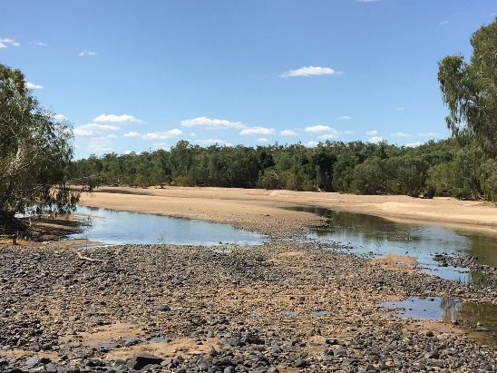
Gilbert River system
Large dams
On-farm storages
Soil water
Groundwater
Riverbed-sand aquifers
Notes:
Why we’re working in the Gilbert ... Follow-up project from CRDC MAR feasibility project
Relatively poor information about the bed sands (MAR looked possible but needed more investigation)
Low uptake of allocations under the Gulf Plan – anecdotal evidence that this was not low demand BUT the result of constraints to water development and agriculture
Low of work done in the past on the Gilbert but where does the knowledge go … reports stuck on a bookcase, lost or not shared with the community.

Slide 3
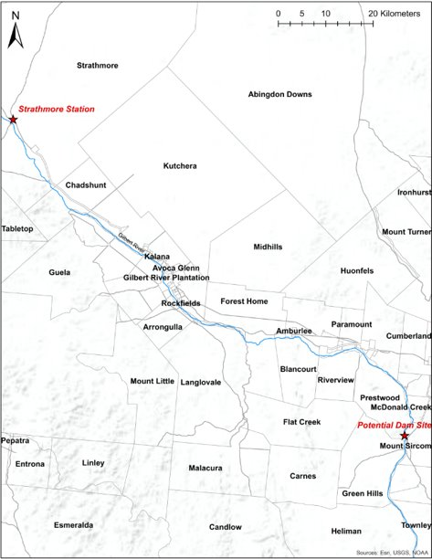
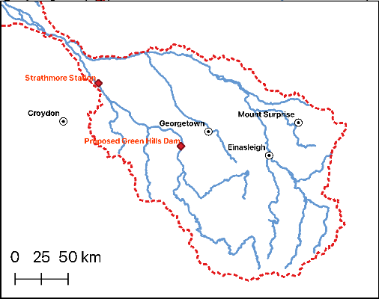
Project overview
Proof-of-concept project looking at how knowledge about water can be organised to support learning over time
It is developing a ‘learning-focused digital twin’
  Combine multiple knowledges
  Take a landscape perspective of water storage options
  Facilitate local scale engagement with water governance
  Kickstart conversation about information sharing and research investment requirements
  Evaluate latent water and water storage demand in the Gilbert River Ag. Precinct
Notes:
Gilbert River Agricultural Precinct (GRAP), west of Georgetown, estimated area of 17,900 ha of fertile soils that could support irrigated agriculture along the Gilbert River
No investment in the proposed Green Hills dam, and water releases have seen low sales
Face value: low interest for water development so why invest in additional research
Anecdotal evidence that there is a latent demand for water and water storage, hidden behind water-related and other barriers and information gaps regarding system operation, management options and pathways for investment.
This work doesn't extend to the Mitchell but is the kind of project that could be replicated elsewhere.

Slide 4
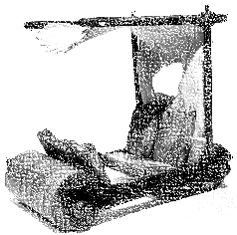
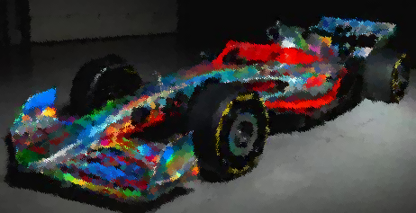
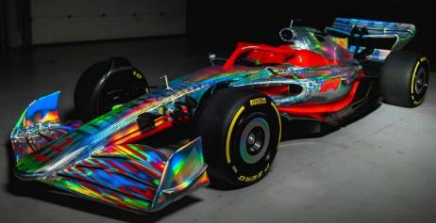
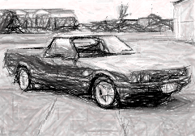
What is a digital twin?
A time-varying representation of a system that brings observed information and predictive modelling together. A structure to …
  Accumulate information and understanding, identify uncertainties and gaps, and reason about the value of new information and potential improvements
Catchment context: imperfect information; complexity of human-environment interactions over space and time
Digital Twin

Slide 5
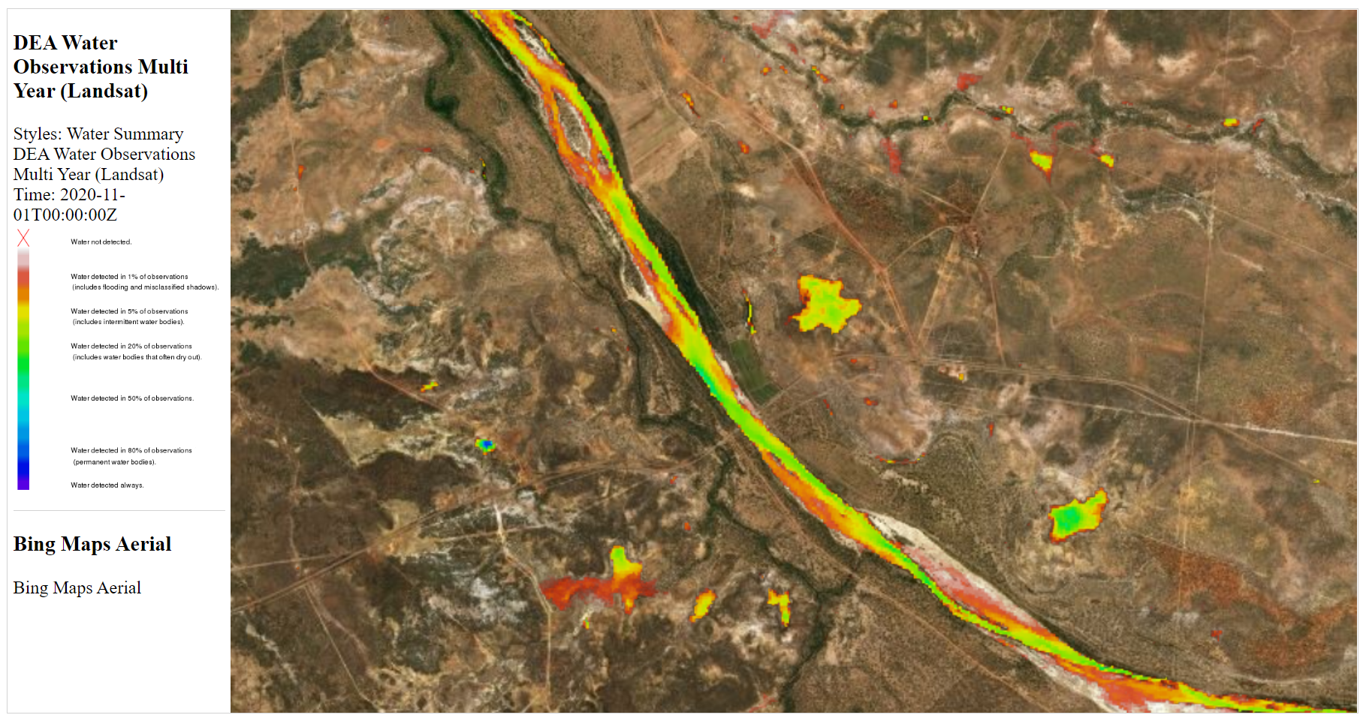
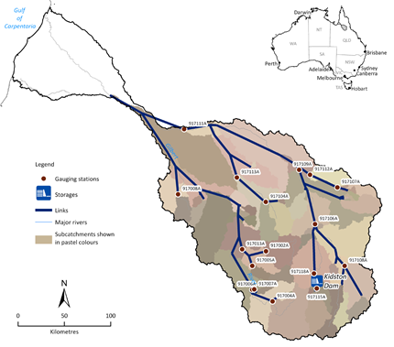
Potential of digital twins in water
Gradual improvement in fidelity over time (how well the digital twin represents reality)
Facilitate communication and understanding amongst stakeholder groups
Complementary approach to existing water modelling paradigms
Notes:
Draw on alternate information (e.g. DEA, local landholder knowledge of rock bars and water in the bed sands)

Slide 6
GRAP digital twin
Project components
Construction of a digital twin platform
Landholder farm visits & interviews
Integration of public data sources
Engagement with state government
Australian Hydrological Geospatial Fabric
BOM flood warning system
eWater Source
Geophysics
Streamflow monitoring
Queensland Globe
Digital Earth Australia Water Observations
AWRA-L
Digital Elevation models
Floodplain assessment
Watercourse lines
Policy & regulation

Slide 7
Landholder engagement
Farm visits and interviews using mapping visualisations from the digital twin
Aim to understand landholders
  Water storage opportunities and constraints on their land
  The data and support needed for improved decision-making on water management on their property
Project components
Construction of a digital twin platform
Landholder farm visits & interviews
Integration of public data sources
Engagement with state government

Slide 8
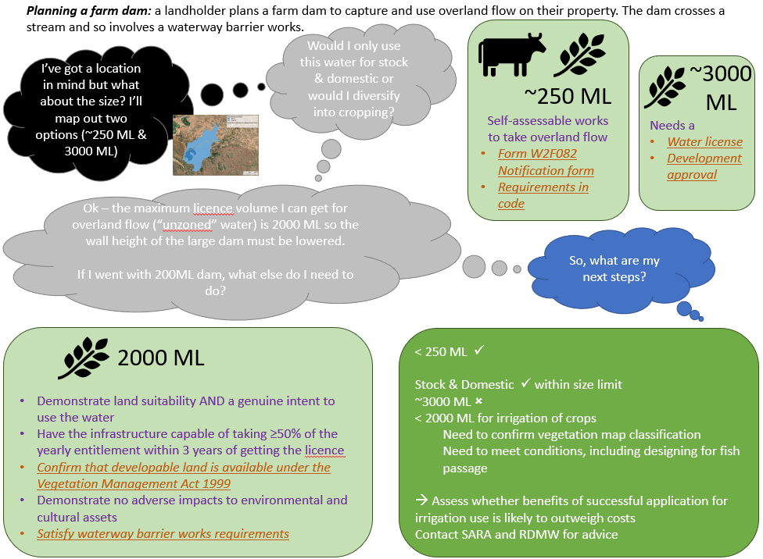
Engagement with State government
Project components
Construction of a digital twin platform
Landholder farm visits & interviews
Integration of public data sources
Engagement with state government
Policy prompt packs
  prompts for discussion of policy processes and knowledge needs through realistic but hypothetical or anonymous cases
  step through the experience of planning a water development … the emphasis is on planning processes
Water models and the Water Plan (Gulf) 2007
  How existing models can (not) be used in landscape-scale planning?
  Opportunities to improve existing models or develop new ones
Notes:
Non-binding policy information source

Slide 9
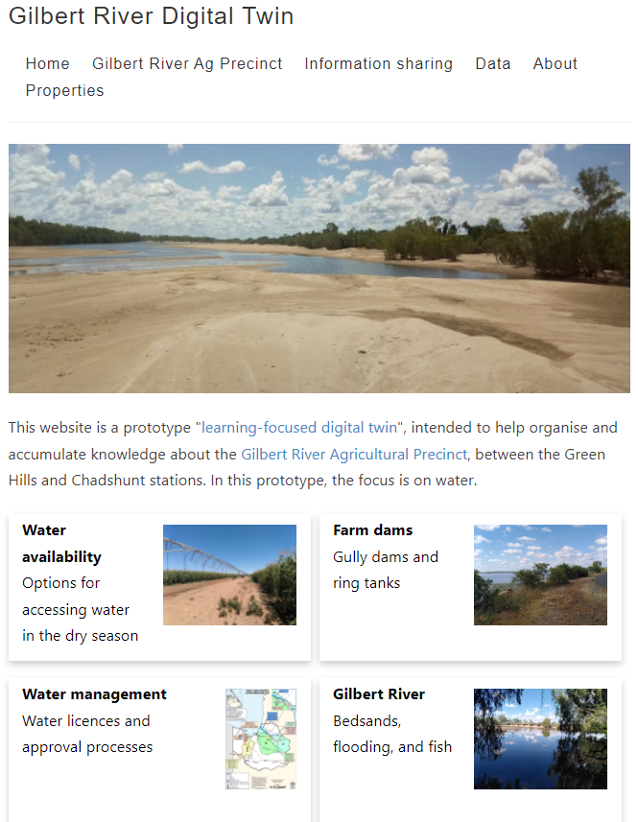
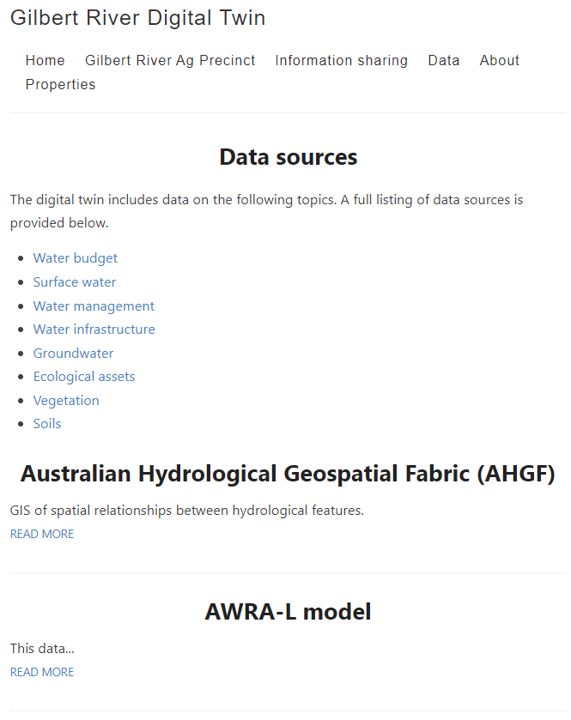
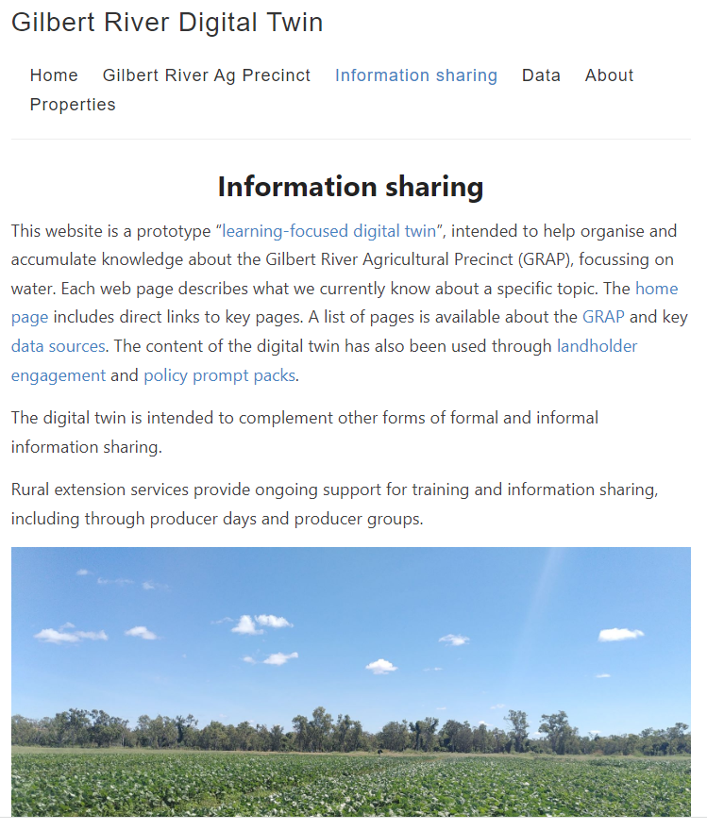
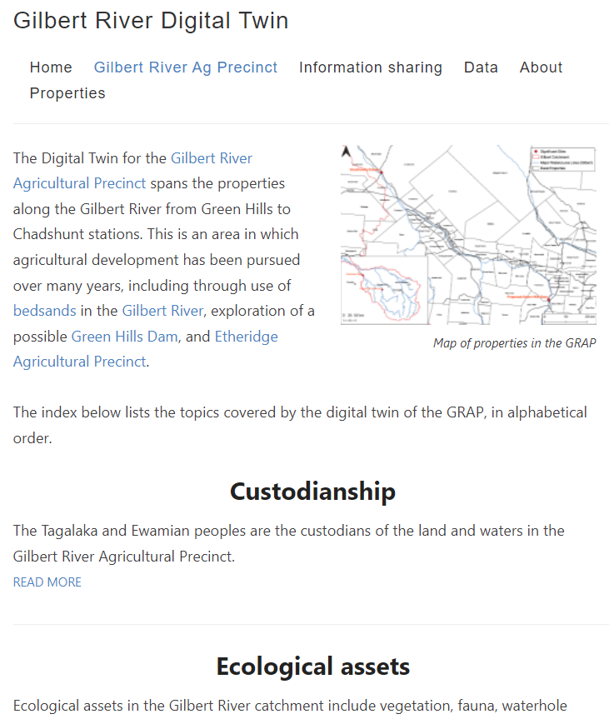
Web portal
(under construction)
Notes:
Going back to our analogy, a Formula 1 racing team might improve performance using digital twin that combine real-time data and computer modelling, ours is seriously low-tech. It’s a web portal that is a snapshot of our knowledge to this point in time.
Place-based topic descriptions for elements of the socioenvironmental system, listed under the Gilbert River Agricultural Precinct
Description of information sharing and the premise of the digital twin
Data source descriptions, intended as summaries of information currently available

Slide 10
Implications for local governance
Focus on NRM bodies as they should be well placed to facilitate local engagement in water governance outside of formal water planning processes. We think the web portal
  plays to the strengths of GSNRM as knowledge and relationship brokers
  provides a repository of knowledge about the GRAP and an additional entry point for landholders to engage with existing NRM services and knowledge governance
  acts as a non-binding source of information (but does link to the ‘official’ information sources)
Beyond this proof-of-concept project
  Will it prove useful or will it end up on the digital bookcase?
  Sustainability of funding: if looking to update/expand in the future, what are the funding/resourcing models?
  Adaptive investment planning: future research / data collection, outreach, industry development

Slide 11
Potential implications for the Mitchell
Where is current knowledge about the Mitchell held?
Would it be useful to have a similar portal for (parts of) the Mitchell?
What conversations about knowledge gaps need to be had? With whom?

Slide 12
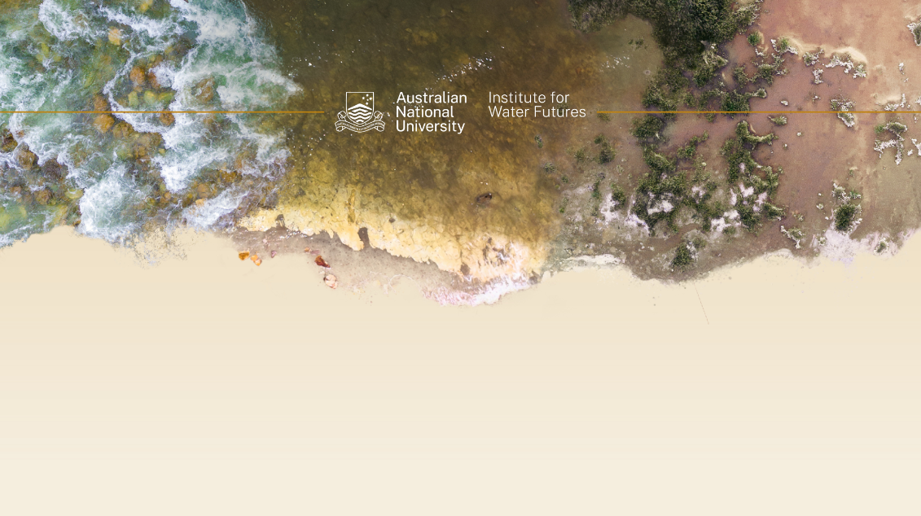
THANK YOU
We acknowledge the Ewamian and Tagalaka peoples as the custodians of the lands and waters that the digital twin aims to represent and value their knowledge of country. We recognise their continuing connection to, and the importance of being able to live on, country and pay our respects to elders past and present.
Wendy Merritt
Fenner School of Environment and Society / Institute for Water Futures
Australian National University
wendy.merritt@anu.edu.au
waterfutures@anu.edu.au

Slide 13
Queensland Water Modelling Network
Queensland Government initiative to improve the state’s capacity to model the quantity and quality of its surface water and groundwater resources.
  Led by the Queensland Department of Environment and Science
2021 tender sought proposals that addressed one of more of five challenge statements
  Improving impact through stronger links between water models and real-world outcomes
  Improving treatment and communication of climate issues in Queensland water models
  Linking water models to innovative knowledge and information
  Optimising groundwater management through a system approach
  Regional Case Study: North west Queensland

