Slide 1
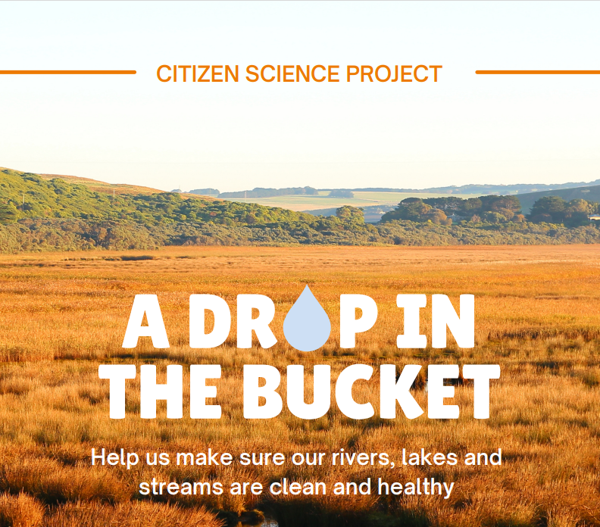

Slide 2
Water quality monitoring kits Provided to 11 schools of the Gulf Savannah
We have provided water quality sampling kits and easy-to-follow instructions for the network of schools to use with their students.
Kits can be used in the same waterway across different seasons, or even in different spots on the same waterway. Each kit provides 10 replicates for Tests 1–7, and 3 replicates for Test 8.

Slide 4
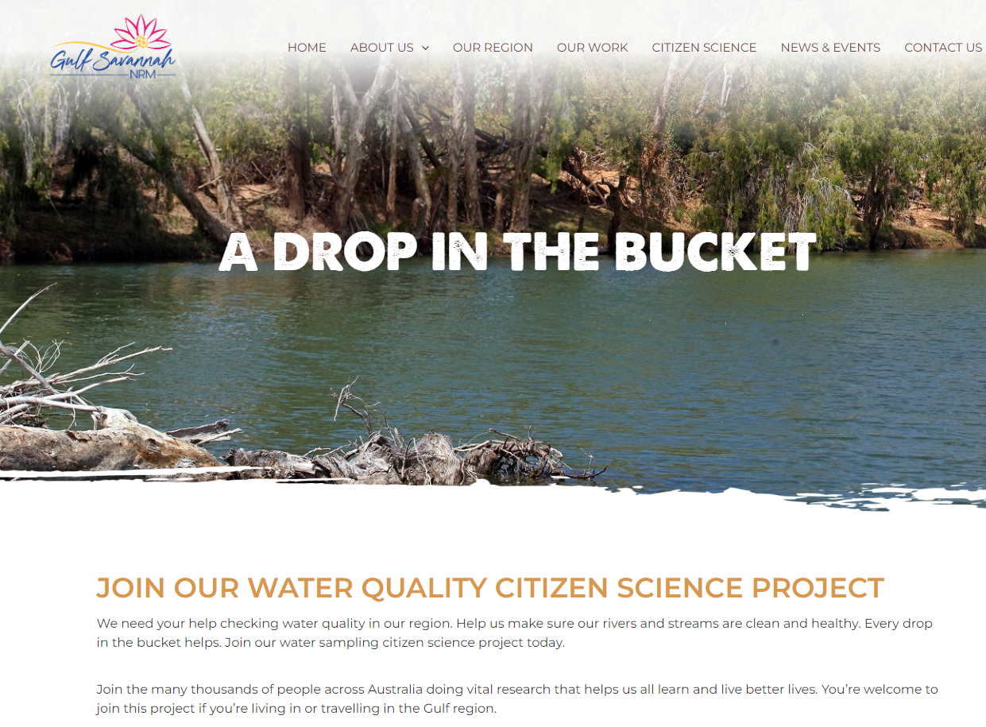

Slide 6
Water way restoration project for MacDonald Creek in Irvinebank

