Slide 1
Arriga Plains Bore Monitoring Project
Brian Prove
Mitchell River Watershed Management Group

Slide 2
Aims
Carry out bore monitoring and sampling in 2017 and 2018
Compare these results to those obtained by Qld DNR
To inform the farmers and landholders in the area of the information gained
To determine any management/mitigation strategies require to manage and live with the situation

Slide 3
INTRODUCTION AND Background
Bores in the Arriga Plains area were monitored by Qld Dept of Natural Resources from 2000 to 2010

Slide 4
Acknowledgements
Mitchell River Watershed Management Group
Australian Government for funding via LandCare
Farmers and landholders who allowed access to their properties to find the bores and sample them
David Morrison and Tracey Whitling, Qld Dept of Natural Resources
Drewe Burgess Canegrowers Mareeba

Slide 5
Methods
Locate all DNR bores and private bores
Measure the depth to the water table with a tape measure and plopper.
Obtain a sample of water from 30cm below the water surface
Measure with a probe electrical conductivity
187 bores, 91were not located and/or damaged

Slide 6
Bore Locations in the Catchment

Slide 7
Watertable Depth Dec 2017 and Oct 2018

Slide 8
Salinity levels
 | Conductivity (uS/cm)
Good drinking water | 0-800
Upper limit for drinking | 800-2500 | Care with irrigation
Brackish | 2,500-10,000 | Not suitable for irrigation
Seawater | 10,000-50,000 | Corrosion
Brine | >50,000

Slide 9
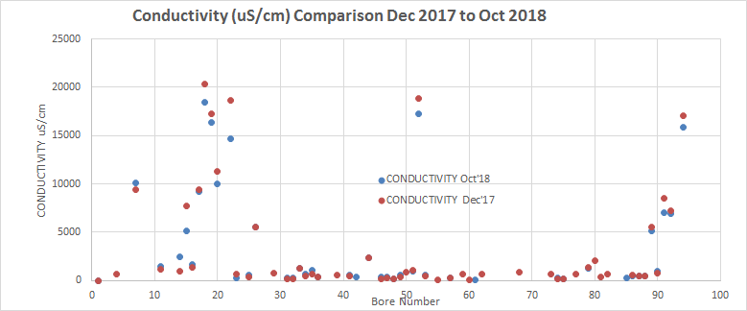
Conductivity Dec 2017 and Oct 2018

Slide 10
Groundwater and Conductivity 2010

Slide 11
Groundwater Risk 2010

Slide 12
2010 Water Quality Summary

Slide 13
Salinity levels
 | Conductivity (uS/cm)
Good drinking water | 0-800
Upper limit for drinking | 800-2500 | Care with irrigation
Brackish | 2,500-10,000 | Not suitable for irrigation
Seawater | 10,000-50,000 | Corrosion
Brine | >50,000

Slide 14
Changes from 2010 to 2017-18
Average rise in watertable height of between 0.2 and 0.5 mteres
No overall change in conductivity or slight decrease
Reasons – dry period for latest monitoring, dewatering by landholders?

Slide 15
Background Rainfall Data Mareeba A’port

Slide 16
Whats next?
Ongoing management and monitoring by who?
Landholders and farmers!
Bores for dewatering noting the need for careful use of saline water
Planting of selective trees in key areas (recharge and high water table areas)
Others

Slide 17
Thank you Any questions

