Slide 1
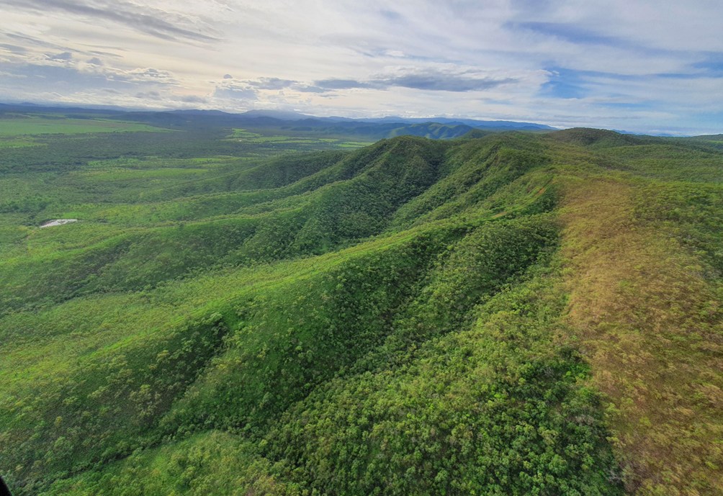
Lakeland Irrigation Scheme - Update September 2021

Slide 2
How We Got Here
2015 - Lakeland irrigators sought improved water reliability and increased volumes
Early 2016 – application through Cape York Sustainable Futures to Commonwealth Government for a Grant
Early 2017 – Commonwealth Grant for $850,000 to CYSF
Objectives
Area of Irrigable land in the Lakeland Area
How much water is required
What sources are available

Slide 3
Strategic Business Case Scope
Need for Scheme
Land and Soil availability and suitability
Water Sources and preferred scheme to meet demand
Technical Feasibility of preferred option
Native Title (Desk Top)
Cultural Heritage (Desk Top)
Environment (Desk Top)
Stakeholder engagement
Economic Analysis, Benefit/Cost
Feasibility Design Drawings
Risk
Next steps

Slide 4
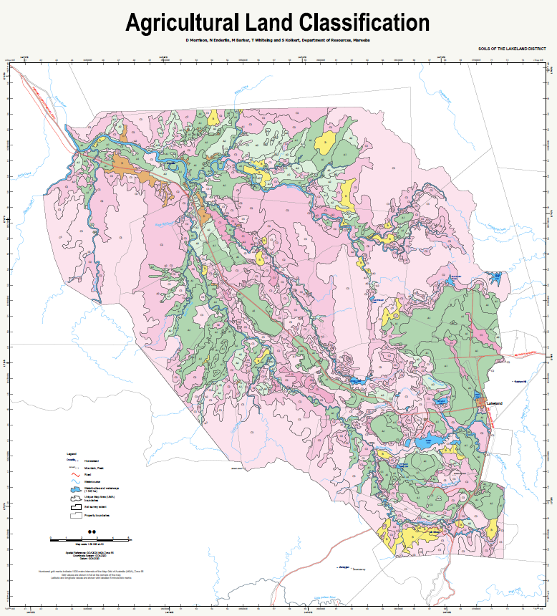
Soil and Land Classification
DNRME investigated an area of 58,442Ha Concluded a total of 17,586Ha suitable for irrigation (Class A & B) 8,000Ha of freehold Class A on the Red Tableland already cleared
Water requirement based on an industry average of 10ML per Ha was 80,000ML

Slide 5
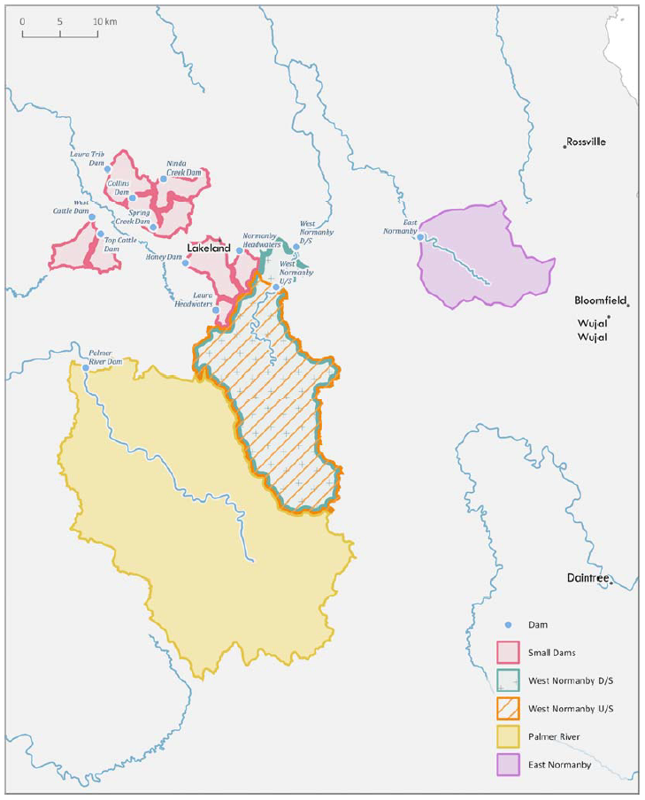
Water Sources
5 sources of water investigated
Additional and augmented on-farm dams which currently service 935.5Ha with an additional 438.5Ha from groundwater sources. This investigation showed that this option would increase current reliability from 50% to 70% but would not sustain significant increases in irrigated land area East Normanby River – Discounted due to: inclusion in National Park, Distance from Lakeland, Small catchment High pumping costs Discharge to Great Barrier Reef West Normanby River – 2 sites: Small catchment would require capture of annual runoff to meet demand High pumping costs Discharge to Great Barrier Reef
Palmer River – 17km downstream from Roadhouse. This option had been identified previously by local farmers: Large catchment -~900km² Large inundation volume ~200,000ML Not in Great Barrier Reef catchment Needs a transfer of water allocation from the Mitchell river system to the Normanby/Laura system

Slide 6
Lakeland Irrigation Scheme – Feasibility Outcomes
The service need was established for additional irrigable land and a new water source to service this area
Part of the Preliminary Business Case was completed by identifying a solution and conducting a Feasibility Analysis on the preferred option - Palmer River Dam
A cost estimate for delivery of a Detailed Business Case was developed, and a potential program of tasks prepared.
Prepared a submission to the Commonwealth Government for the next stage – a Detailed Business Case.

Slide 7
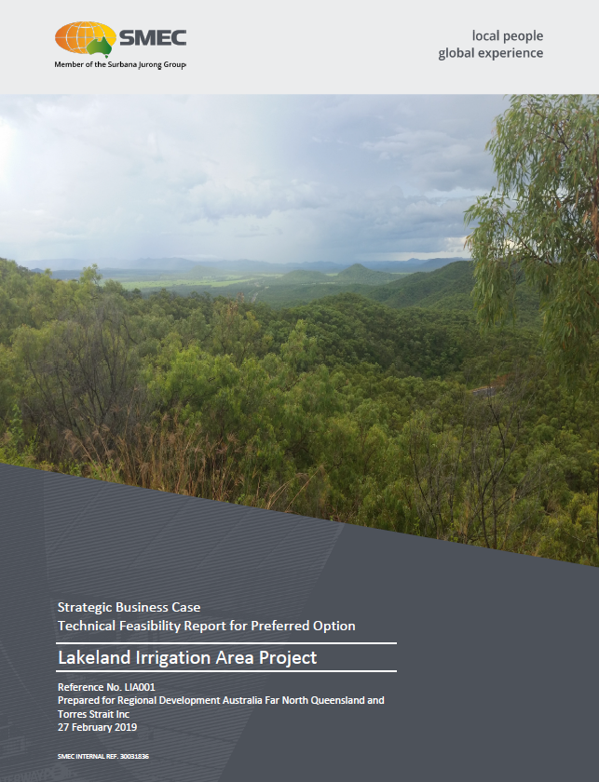
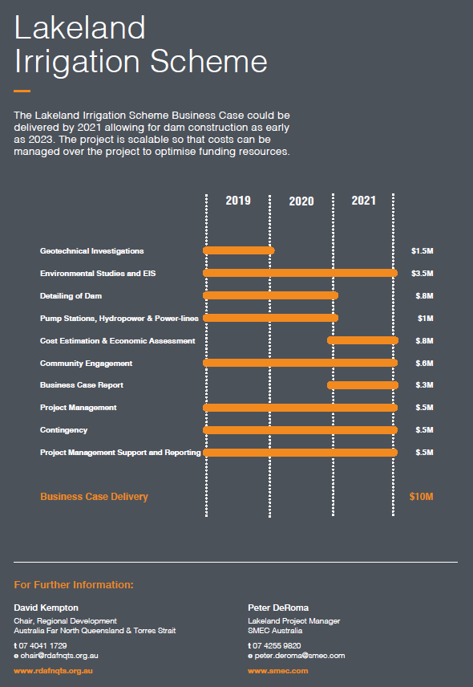
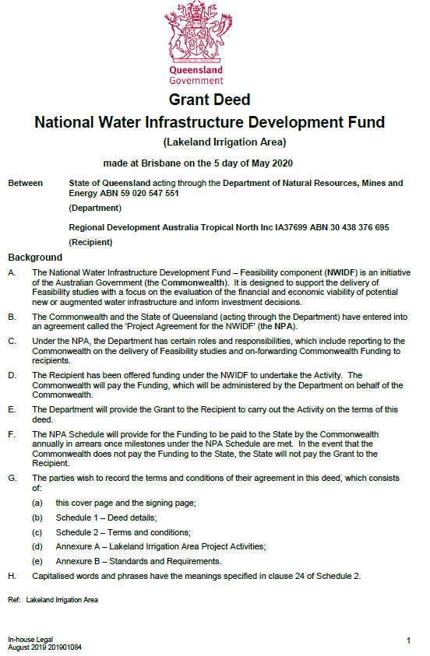
Outcome
Feb 2019 – Strategic Business Case (SBC) and Feasibility of the Palmer Option released by RDA
Mid to late 2019 – application by RDATN Commonwealth Government for a Grant to undertake a Detailed Business Case (DBC) for the Palmer River Option
May 2020 – Commonwealth Grant for $10M to progress the DBC to RDATN
Objectives: A. Provide an acceptable Price per ML for growers Prepare a Reference Design for a Dam, transfer system and reticulation to meet Objective A Investigate all technical as well as cultural, social, environment and economic aspects. Investigate Funding, Ownership and Operating models

Slide 8
Lakeland Irrigation Scheme
Extent and Configuration
(Sept 2021)
3 Components:
Dam
Transfer from dam to Lakeland
Reticulation to farms

Slide 10
Lakeland Irrigation Scheme – Progress on Palmer Option
Review of the Strategic Business Case for suitability
Most field work has been completed:
Geotechnical drilling on preferred dam location including cultural heritage clearance for access
Dry and Wet season environmental data collection
Preliminary dam options for sizing
Decision taken to transfer water from the dam to the Lakeland distribution system by tunnel to avoid having to pump to the top of the Dividing Range
Consideration of hydro electricity from the escarpment to the valley
Options for a distribution network of pipes to service land.
Preliminary Social Impact study
Stakeholder engagement commenced including community, indigenous and irrigators
Extensive topographical survey (aerial and drone) for dam and Lakeland
Preliminary agriculture/agronomy confirmation
Water resource modelling and assessment
Economic assessment and reporting commenced
Preliminary assessment of fishway provision

Slide 11
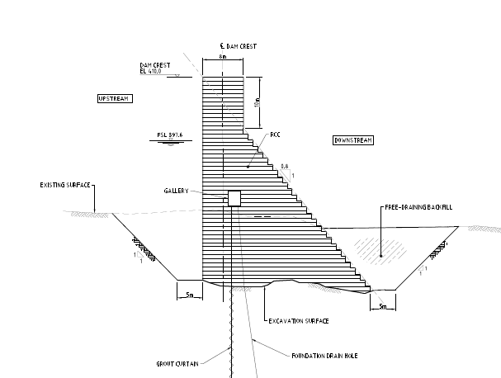
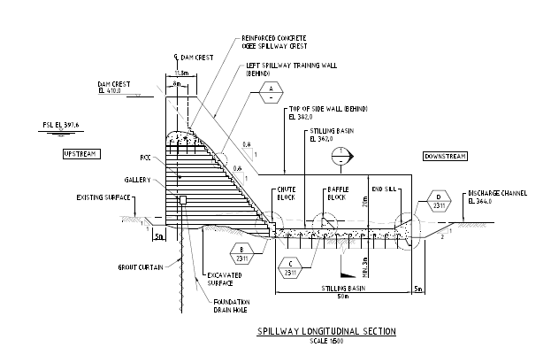
Lakeland Irrigation Scheme – Progress on Palmer Option
Current outcomes include:
Preferred dam type is Roller Compacted Concrete
Preliminary scheme costings
Review of distribution network for efficiency
Standalone power supply not supported
50% Reference Design complete
Current project will not service areas outside the currently cleared areas on the ‘red tableland’ but will investigate water security to all of the irrigable land (which includes Crocodile Station). This is currently viewed as a range of sizes of storage based on the current dam location but with the dam level at increased elevation. A further alternative could exist within the preferred dam size depending on uptake of water and water usage rates.

Slide 12
Lakeland Irrigation Scheme – Progress on Palmer Option
On-going work includes:
Geotechnical interpretive reporting
Milestone 5 report delivered in mid September – Includes detailed geological assessment.
Catchment hydrology and scheme reliability
Dam and flood hydrology
Regional flood assessment
Palmer River bridge flood impact assessment from higher dam elevations
Failure Impact Assessment
Multi Criteria Assessment of scheme options
Geotechnical investigations for construction materials and transfer tunnel
Source based catchment modelling to assess changes in pollutant loads for the Mitchell and Normanby catchments
Environmental Impact Assessment

Slide 13
Lakeland Irrigation Scheme – Issues still to be addressed
Water allocation including cross catchment from Mitchell to Normanby and any impacts on downstream users in the Palmer or Mitchell areas
Potential benefits by supplementing flows in the Laura River from reduced Farm runoff (currently stored in on-farm dams)
Improvements in agricultural irrigation practices as a positive impact on the Great Barrier Reef
Social benefits of increasing agriculture at Lakeland including:
Population increase
Additional community, social and health services
Opportunities for service centre for Lower Cape York Peninsula
Indigenous engagement and opportunities e.g. near the dam, and Crocodile
Scheme funding and sponsorship (Fed, State, local)
RDATN will seek a Coordinated Project under the Coordinator General

Slide 14
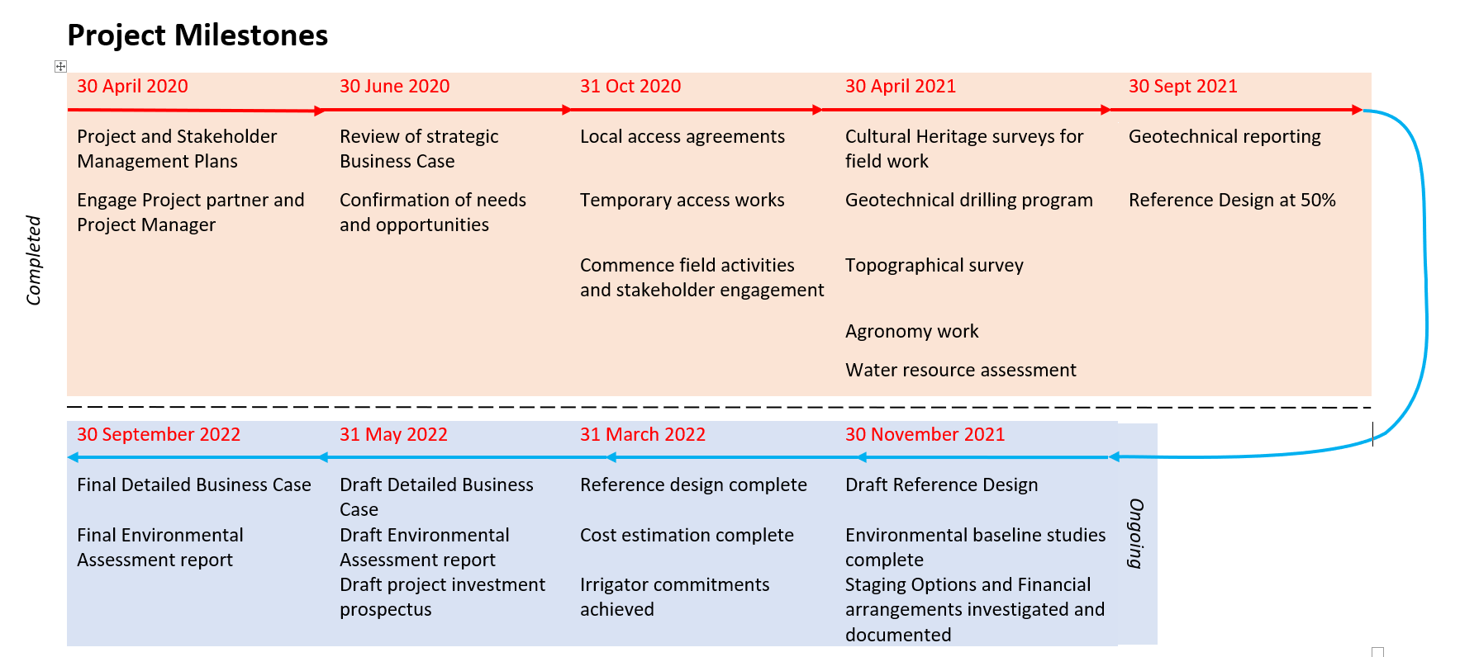
Lakeland Irrigation Scheme – Milestones

Slide 15
Scheme for Reference Design

